Slide 1
EECE 5698
Robotics Sensing and Navigation
Homework 3
GPS Receiver Data Analysis

Slide 2
General procedure
Building files
Build a structure that includes typedefs for time, latitude, longitude and altitude
Build a device driver to log all the $GPGGA message
Make change on speaker & listener files to make sure they are on the same channel
./runspy.sh # make sure lcm-spy can show statistics about the GPS structure in real time
Download utm and include utm_x, utm_y in the driver, speaker and listener files
Run files
Sudo minicom -s # change the port name to /dev/ttyUSB0 and set the speed as 4800 bits/second
Lcm -gen -p ‘structure_name’ # generate related python file
Runspy.sh # run lcm-spy
Open a new terminal run: lcm-logger -s ./data/lcm-log-%F-%T & # save those data in “data” folder for further analysis
Open a new terminal run: python listener_mod.py #note that everytime you send anf receive message, the spy and logger information will change
Open a new terminal run: python send-message.py
Use MATLAB to plot utm_x vs. utm_y

Slide 3
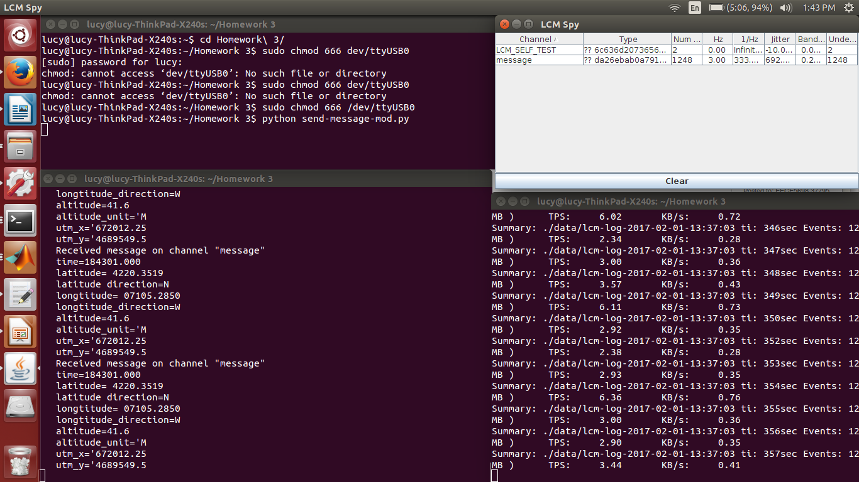
Screenshot of data collection

Slide 4
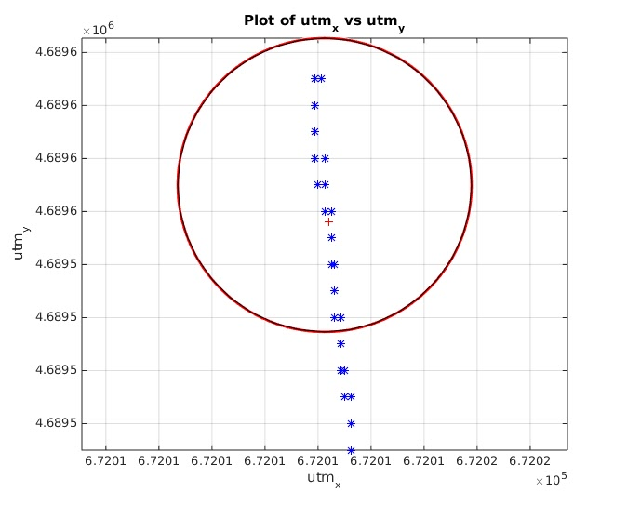
Plot of stationary spot

Slide 5
Analysis of stationary spot’s plot
For collecting stationary GPS data, I stayed at one outdoor places for ~10 min. And then imported utm_x and utm_y to MATLAB, plotted them out.
On this figure:
Blue ‘x’ dots show pairs of utm_x and utm_y data
Red ‘+’ sign shows the mean value
Circle indicates Circular Error Probability (CEP)
For the CEP, I picked the point that is in the middle of data collection time, which is around 5 min. And the radius is calculated as 0.62*sigma_y + 0.56sigma_x, we also make sure sigma_y /sigma_x > 0.3 to make sure the analysis based on it is reliable.
Based on the reference manual, with the drawn circle,it should contain the position estimate with a percentage of 50%.
On my plot, there are more than 50% of position data falls inside the circle, so the data collected by this GPS receiver should be considered as reliable.
Also there are some variances on data even we stayed at one spot without moving at all, it could cause by the noise. My guess would be the noise introduced by communication between GPS receiver and satellite when receiving GPS signal.

Slide 6
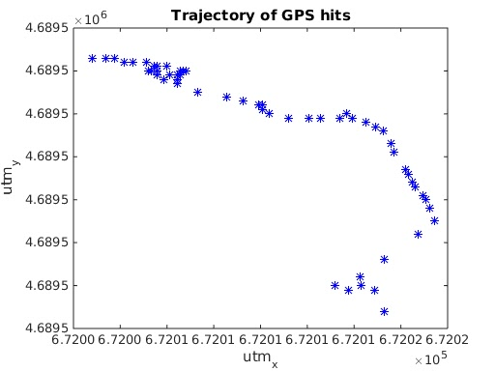
Plot of one-minute walk
For collecting this group of data, I tried to walk in a straight line for 1 min outside the Snell library. And then imported utm_x and utm_y to MATLAB, plotted them out.
From the trajectory of GPS hits, it looks like the middle part of data looks more closely to a straight line, while the others seem to be twisted.
There are several reasons for causing that:
There always many people coming across library, so sometimes I have to stop and wait for people to pass, and it could show in the plot, there are some GPS data that are very close/overlap with each other.
The noise of GPS receiver. My guess would be the noise introduced by communication between GPS receiver and satellite when receiving GPS signal.

Slide 7
References
“GPS Position Accuracy Measures.” (2003): n.pag. Nov-Dec.2003. Web. 1 Feb. 2017.
"Lcm-spy(1) - Linux Man Page." Lcm-spy(1): Traffic Inspection Tool - Linux Man Page. N.p., n.d. Web. 01 Feb. 2017.
"Lcm-gen(1) - Linux Man Page." Lcm-gen(1): Code Generation Tool - Linux Man Page. N.p., n.d. Web. 01 Feb. 2017.
"Lcm-logger(1) - Linux Man Page." Lcm-logger(1): Data Logger - Linux Man Page. N.p., n.d. Web. 01 Feb. 2017.
"Lcm-logplayer(1) - Linux Man Page." Lcm-logplayer(1): Minimalist Log Playback Tool - Linux Man Page. N.p., n.d. Web. 01 Feb. 2017.

